Slide 1
CONVENTIONAL WATER TREATMENT PLANT
Water treatment is the process of removing contaminants from wateewater and household water.
It include physical , chemical and biological processes to remove physical , chemical and biological
Contaminants.
Its objective is to produce an environmentally safe fluid waste stream and a solid waste suitable for disposal or reuse .

Slide 2
IMPORTANCE OF WATER TREATMENT PLANT :-
SCREENING
AERATION
FLOCULAYION
SEDIMENTATION
FILTERAION
DISINFECTION
SOFTENING

Slide 3
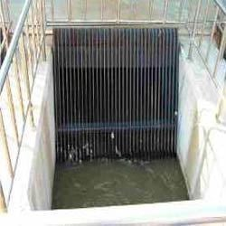
SCREENING
Screening is done to carry out remove of heavy suspended solid from the water.
like :- plants , stones , tress , etc
Screening is generally adopted for the treatment of surface water.
Screening is done with the help of …….
1) Coarse Screen
2) Fine Screen

Slide 4
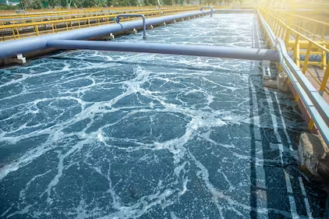
AERATION
It is the process in which water of brough intimate contact of air .
It removes undesirable gases . CO2 , H2S.
It removes undesirable organic matter.

Slide 5
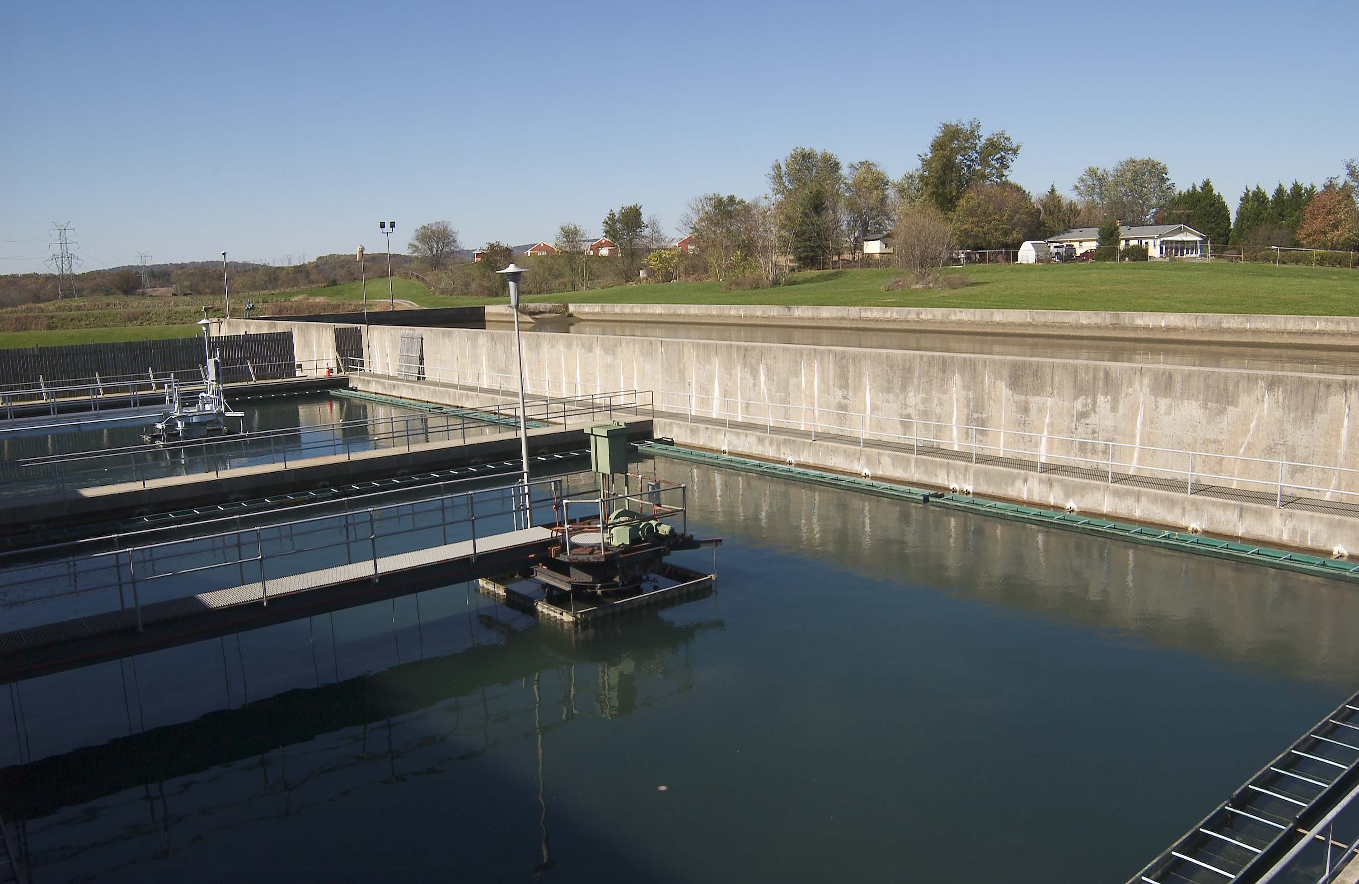
FLOCULATION
It is the process in which naturalize particle are in contact with each other ,
so as to promote their resulting in increased size.

